Slide 1
Getting Started with the Web
Introduction to HTML & Web Technologies
Presented by: Manal Asghar
Course: Web Development

Slide 2

Internet
Global network connecting computers for data sharing.

Slide 3
Web, Web Pages & Websites:
Web (World Wide Web) : Part of the internet that hosts websites and web pages, accessed through browsers.
Web Page: Single page with text, images, links, etc.
Website: Collection of multiple web pages (e.g., Google.com, Wikipedia.org). Connected through hyperlinks

Slide 4
How a Website Works?
You type a website address in the browser.
The browser sends a request to the server.
The server sends back website files (HTML, CSS, JavaScript).
The browser shows the website on your screen.
Simple Flow: User → Browser → Server → Browser → Websites
“When we type a website name, the browser asks the server for the website, and the server sends it back and browser displayed on the screen.”

Slide 5
Basic File Types
HTML: Structure of a page.
CSS: Styles and layout.
JS (optional for now): Adds interactivity.
Difference between Frontend & Backend –
Frontend: What user sees (HTML + CSS).
Backend: Server-side logic and databases.

Slide 6
Evolution of HTML & Web Technologies
HTML Versions
HTML (1991) – Created by Tim Berners-Lee
HTML 2.0
HTML 4.01
XHTML
HTML5 (Latest & Modern standard)
Web Technologies Evolution
Static Websites (Only HTML)
Dynamic Websites (PHP, ASP)
Modern Web Apps (React, Angular, APIs)

Slide 7
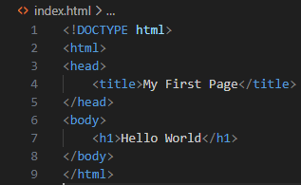
Structure of an HTML Page
Defines HTML5
Basic structure:
Explanation:
Root element
Metadata
Visible content

Slide 8
Structure of an HTML Page
The <!DOCTYPE html> declaration defines that this document is an HTML5 document
The <html> element is the root element of an HTML page
The <head> element contains meta information about the HTML page
The <title> element specifies a title for the HTML page (which is shown in the browser's title bar or in the page's tab)
The <body> element defines the document's body, and is a container for all the visible contents, such as headings, paragraphs, images, hyperlinks, tables, lists, etc.
The <h1> element defines a large heading
The <p> element defines a paragraph

Slide 9
HTML Tags & Elements
What is a Tag?
Tags are keywords enclosed in angle brackets.
Example:
<p>This is a paragraph</p>
<p> → Opening tag
</p> → Closing tag
Content in between
Types of Tags:
Paired Tags (e.g., <h1></h1>)
Self-closing Tags (e.g., <br>, <img>)

Slide 10
DOCTYPE Declaration
<!DOCTYPE html>
Purpose:
Tells the browser which version of HTML is used.
Ensures proper rendering.
In HTML5, it is simple and clean.

Slide 11
Tools Setup
Install Code Editor
Visual Studio Code
Useful Extensions:
Live Server
Prettier (Code Formatter)
Browser Developer Tools:
Inspect element
View source
Console tab

Slide 12
Practical – Create Your First HTML Page
Open VS Code
Create new file → index.html
Write basic HTML structure
Save file
Open with Live Server

Slide 13
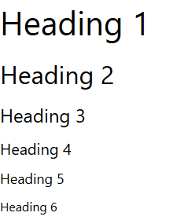
HTML Headings
HTML headings are defined with the <h1> to <h6> tags.
<h1> defines the most important heading. <h6> defines the least important heading.
<h1>Heading 1</h1>
<h2>Heading 2</h2>
<h3>Heading 3</h3>
<h4>Heading 4</h4>
<h5>Heading 5</h5>
<h6>Heading 6</h6>

Slide 14
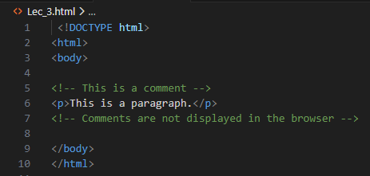
HTML Comment Tag
You can add comments to your HTML source by using the following syntax:
<!-- Write your comments here -->

